Slide 1
Acknowledgement Internet Images, available in Public Domain, have been used in many Slides of this Presentation. Some of the Images have also been Modified/Superimposed. Used only for Academic Purpose/Understanding.
Lecture-8
Takeaways :
Concept of Frequency Response & Introduction to Bode Plots
Understanding Bode Magnitude Plots for Obtaining Corner Frequencies of Dynamical Systems
Relating Rise Time & Bandwidth for Appropriate Sensor Selection based on Process Dynamics
Discretization for Digital Control --- Introduction to the Concept of z-transforms
Introduction to State Space Framework

Slide 2
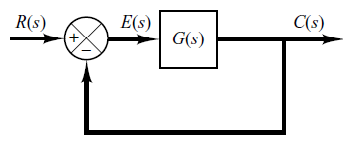
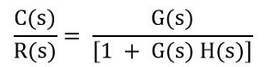
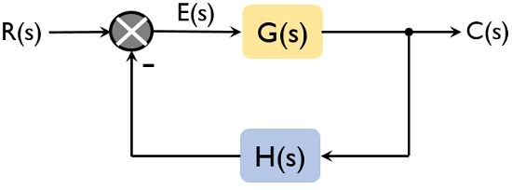
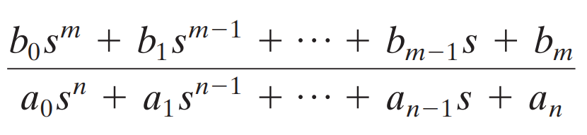

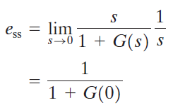
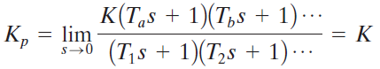
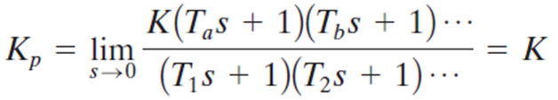

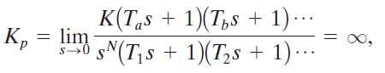

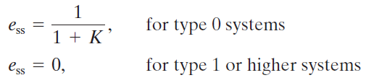
Review of Steady State Error
System Type --- No. of Free Poles / Integrators

Slide 3
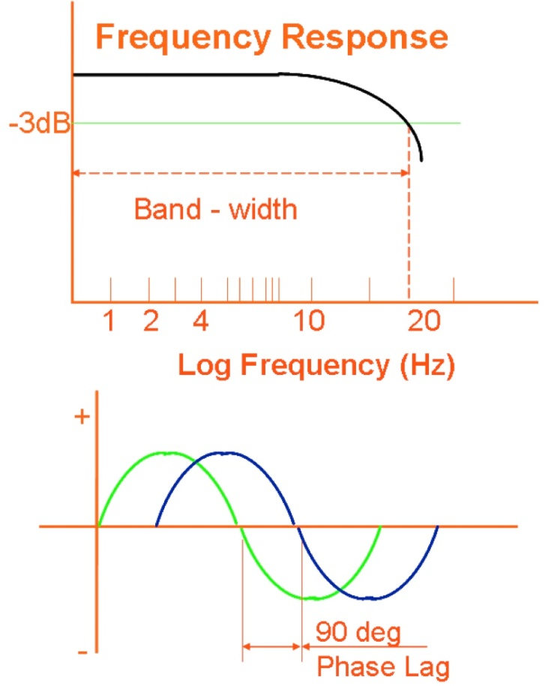
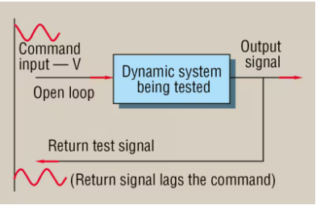
Conceptualizing Frequency Response
By the term frequency response, we mean the steady-state response of a system to a sinusoidal input.
In frequency-response methods, we vary the frequency of the input signal over a certain range and study the resulting response

Slide 4
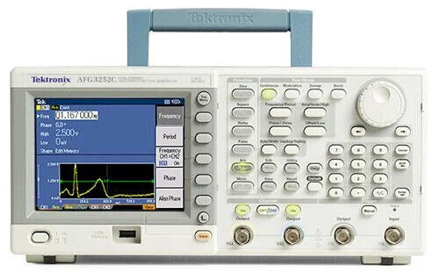
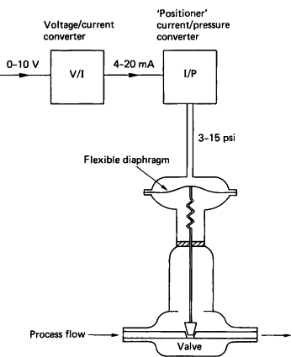
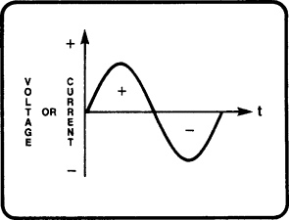
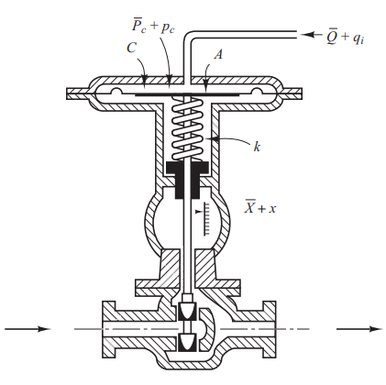
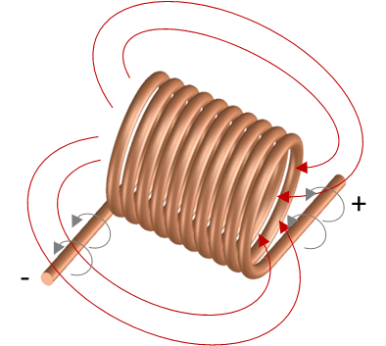
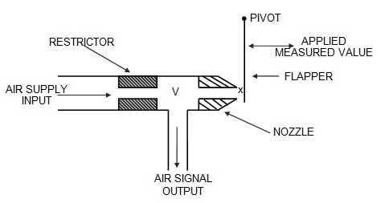
Frequency Response on Field Equipment
Amplitude
Frequency

Slide 5
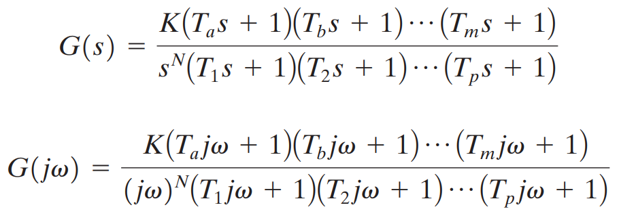
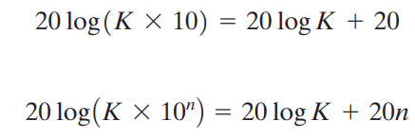
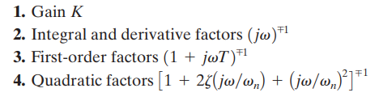
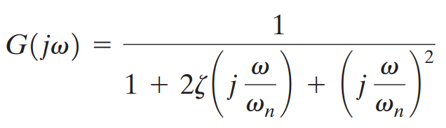
The Frequency Domain

Slide 6
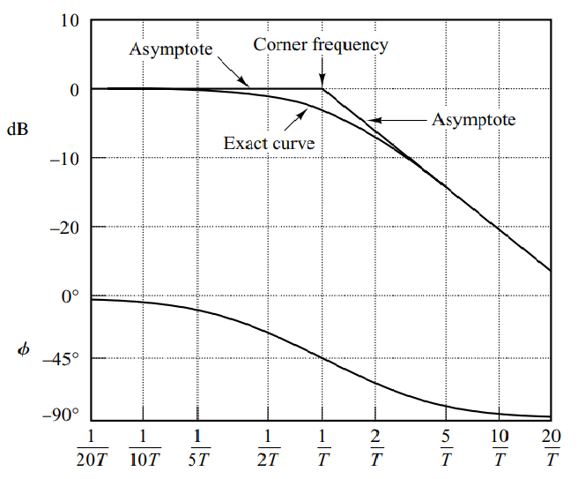
Using Bode Plots

Slide 7
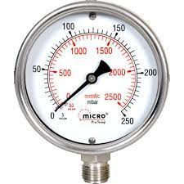
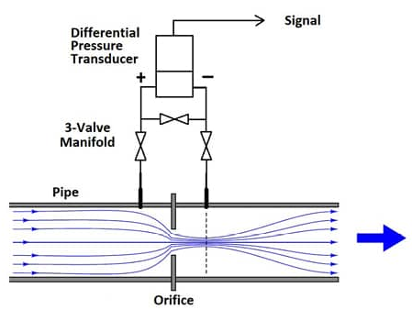
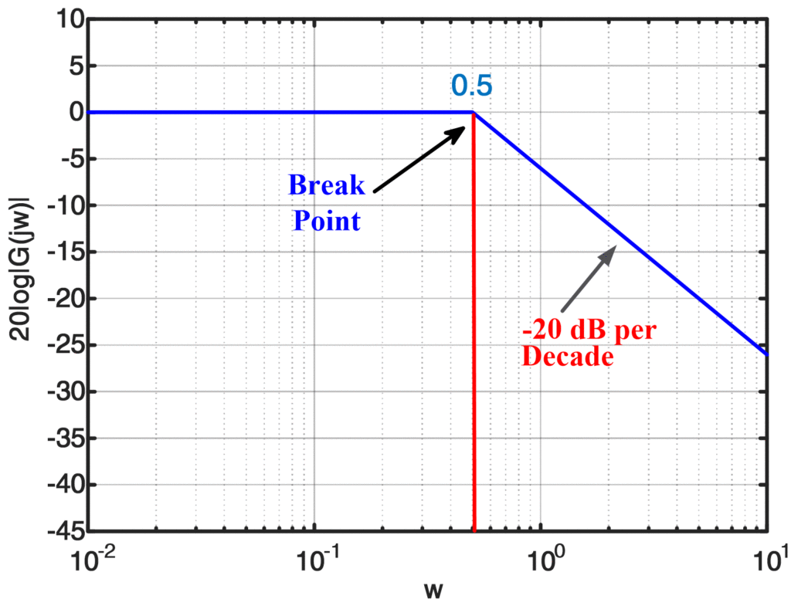
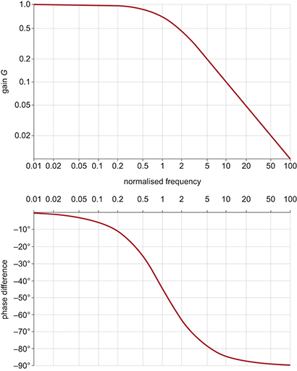
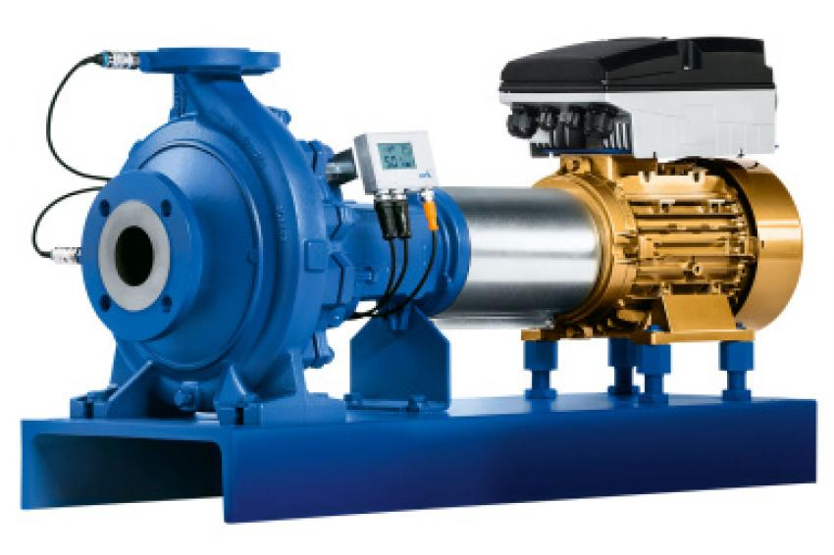
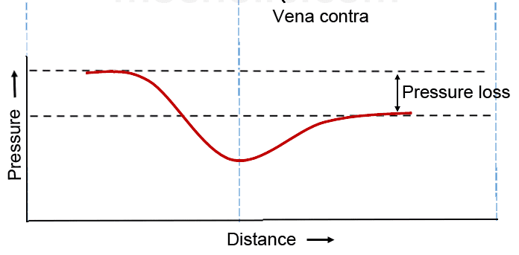
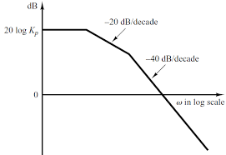
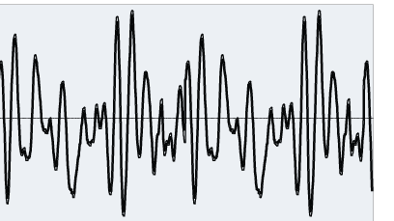
Sensor Selection for Steady State Monitoring & Transient Monitoring

Slide 8
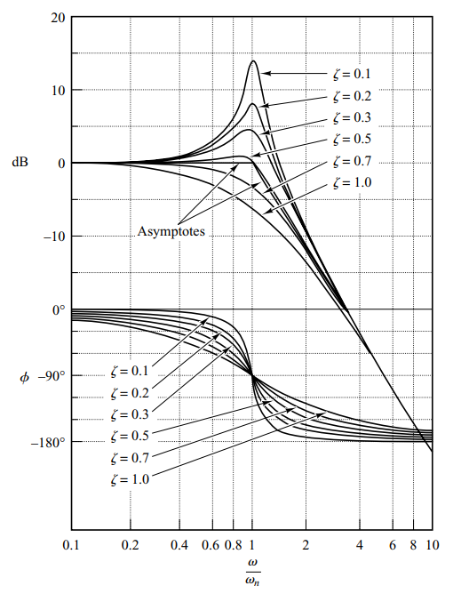
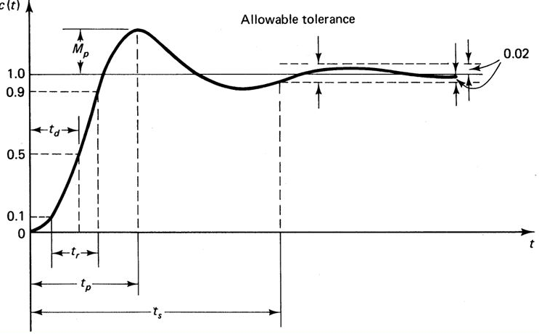
Relating Bode Plots with Damping Factor

Slide 9
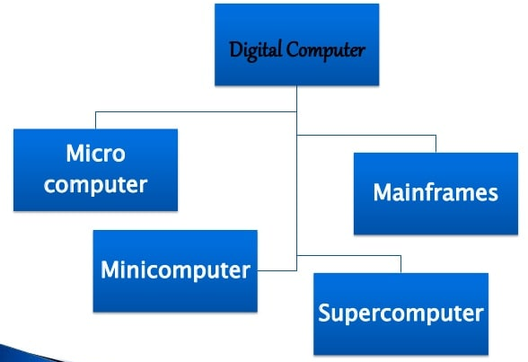
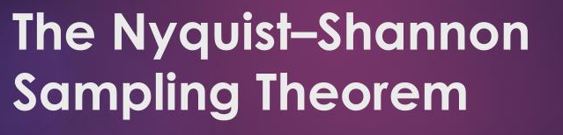
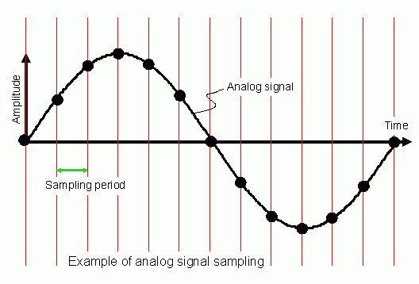
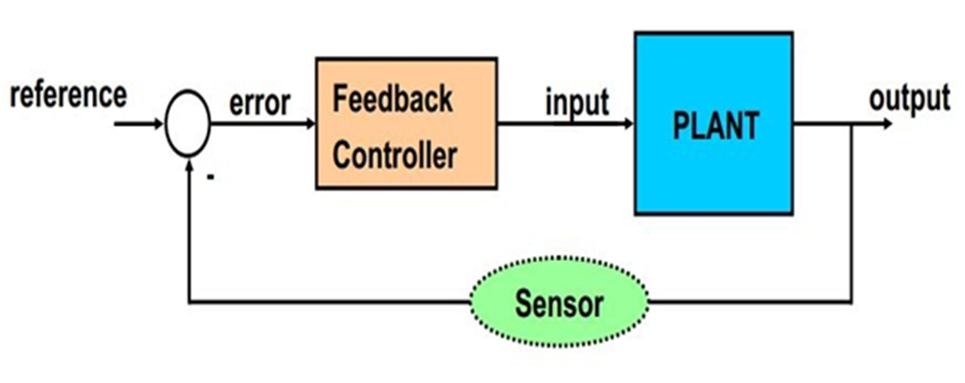
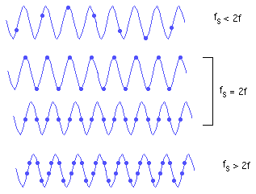
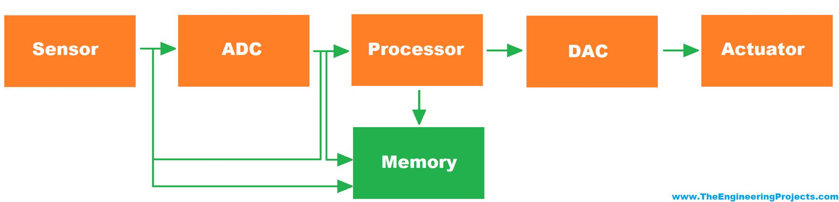
Growth of Digital Controls

Slide 10
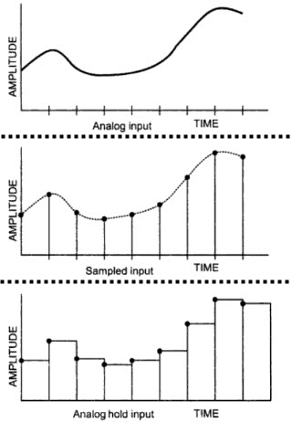
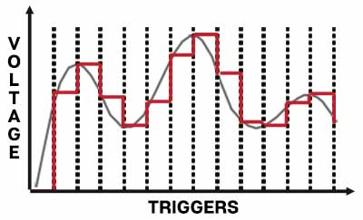
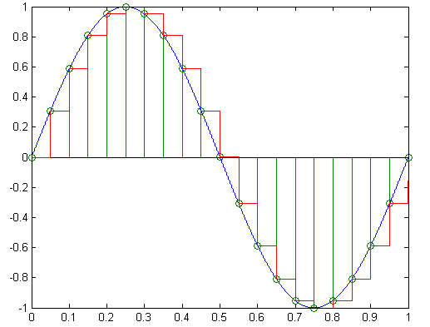
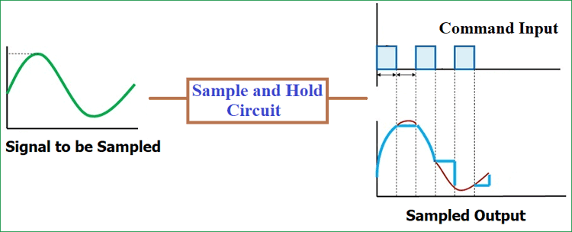
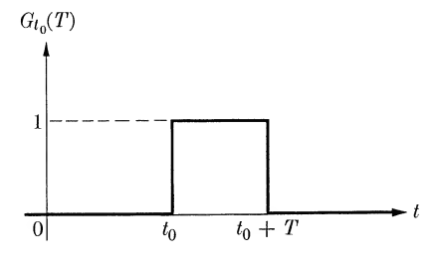
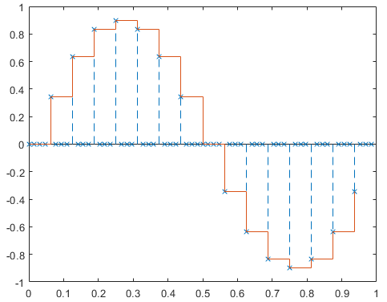

Hold at Sampling Instants

Slide 11
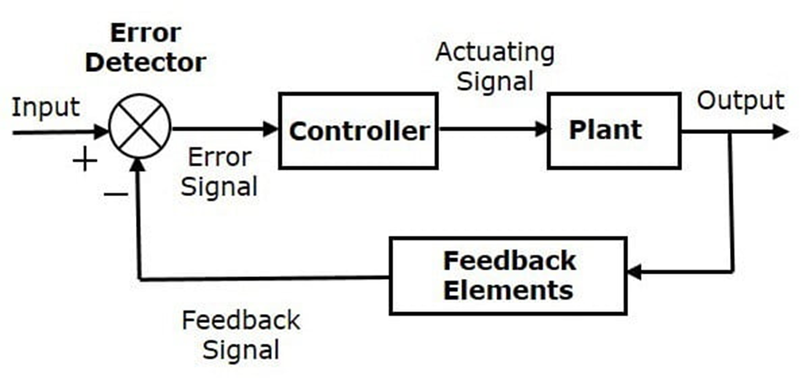
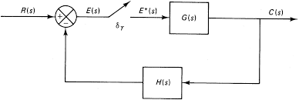
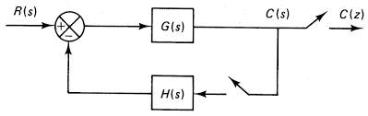
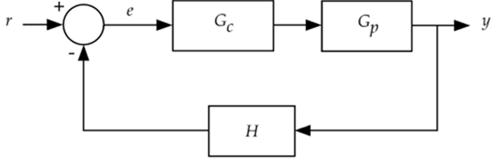
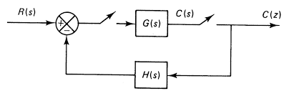
Sampling the Control Loop

Slide 12
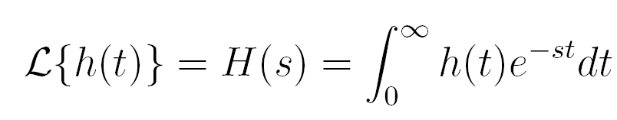


Sampling the Control Loop : The Z-Transforms

Slide 13



Casting the Problem in s-domain and then converting to z-domain

Slide 14






Z-Transforms

Slide 15



Limitations of the Transfer Function Approach for
Multi Variable Problem Solving

Slide 16
Visualizing the State Space Framework
Any Dynamic System comprises of internal variables, termed as States
No. of States,
Same as Order
of the System
--- effectively the
Number of Energy
Storing Elements
in the System
Knowledge of the
Position & Dynamics
of the States, may
Completely define the
System Dynamics
The Abstract Boundary of the Dynamic System
States
x
x
x
x
x
Similar to Molecules in Newtonian Mechanics
x

Slide 17


The Concept of State Transfer
Input Space
U
Observation
Space
Y
State Space
X(1)
State Transfer
X(0)
Time Driven

